Slide 1
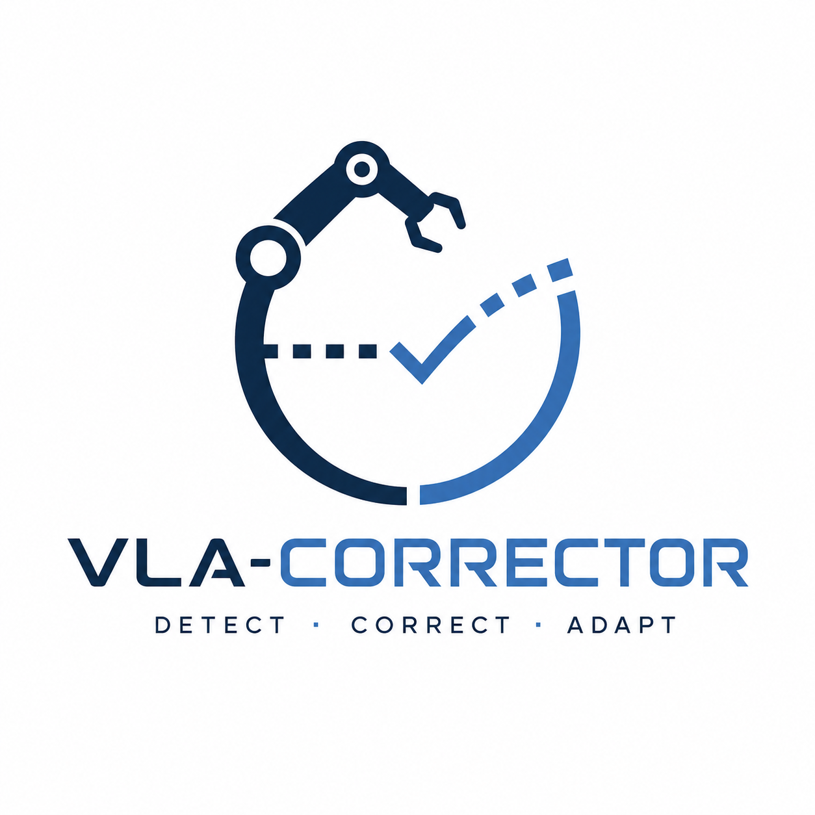
VLA-Corrector
Lightweight Detect-and-Correct Inference
for Adaptive Action Horizon
Yi Pan, Miao Pan, Qi Lu, Jiaming Huang, Man Zhang, Siteng Huang, Xin Li, Jie Zhang, Yongliang Shen, Xuhong Zhang, Wenqi Zhang
Code: github.com/ZJU-OmniAI/vla-corrector · arXiv: arxiv.org/abs/2607.01804

Slide 2
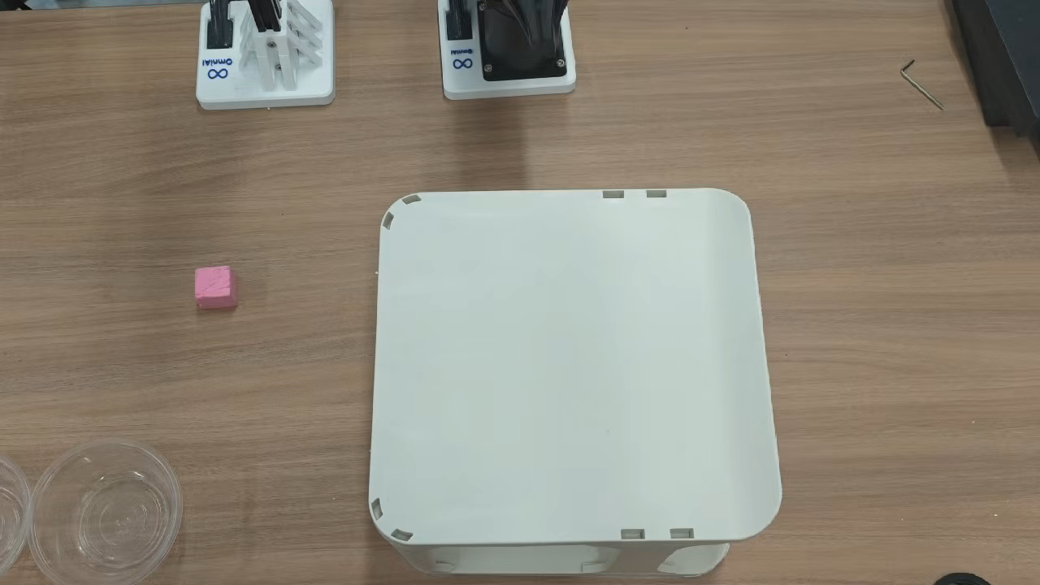
01 MOTIVATION
Open-loop VLA execution leaves blind spots.
Action chunks make VLA execution efficient, but also open-loop.
When unexpected drift occurs, the robot may keep executing stale actions.
This blind spot can turn small errors into task failure.
Task failed because of stale action

Slide 3
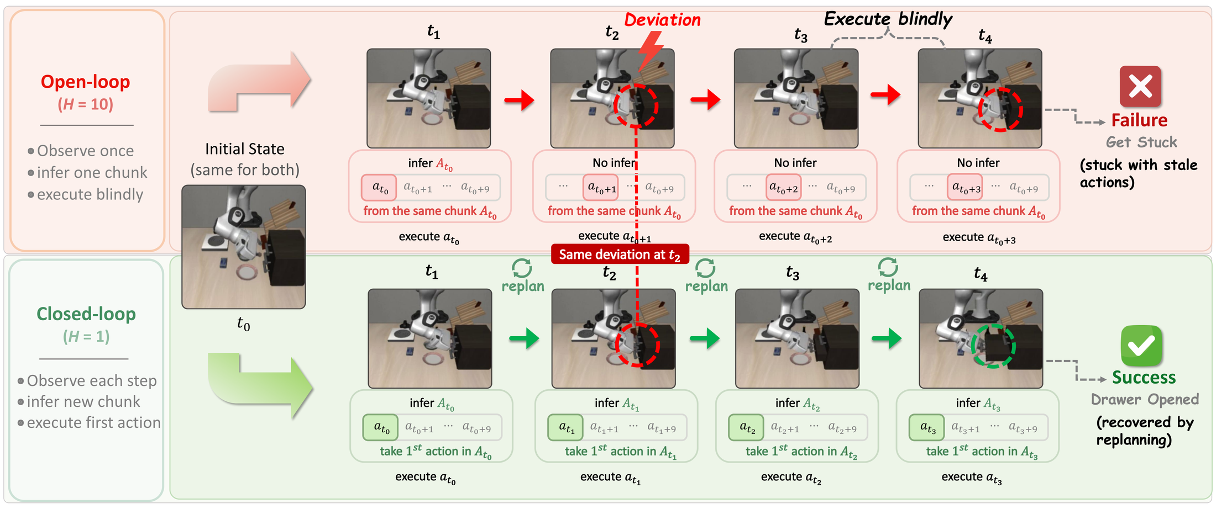
01 MOTIVATION
Action horizon brings performance-efficiency trade-off
Long action horizon
Per-step replanning
Efficient VLA calls, but queued actions can become stale after drift.
More reactive, but expensive for large VLA policies.

Slide 4
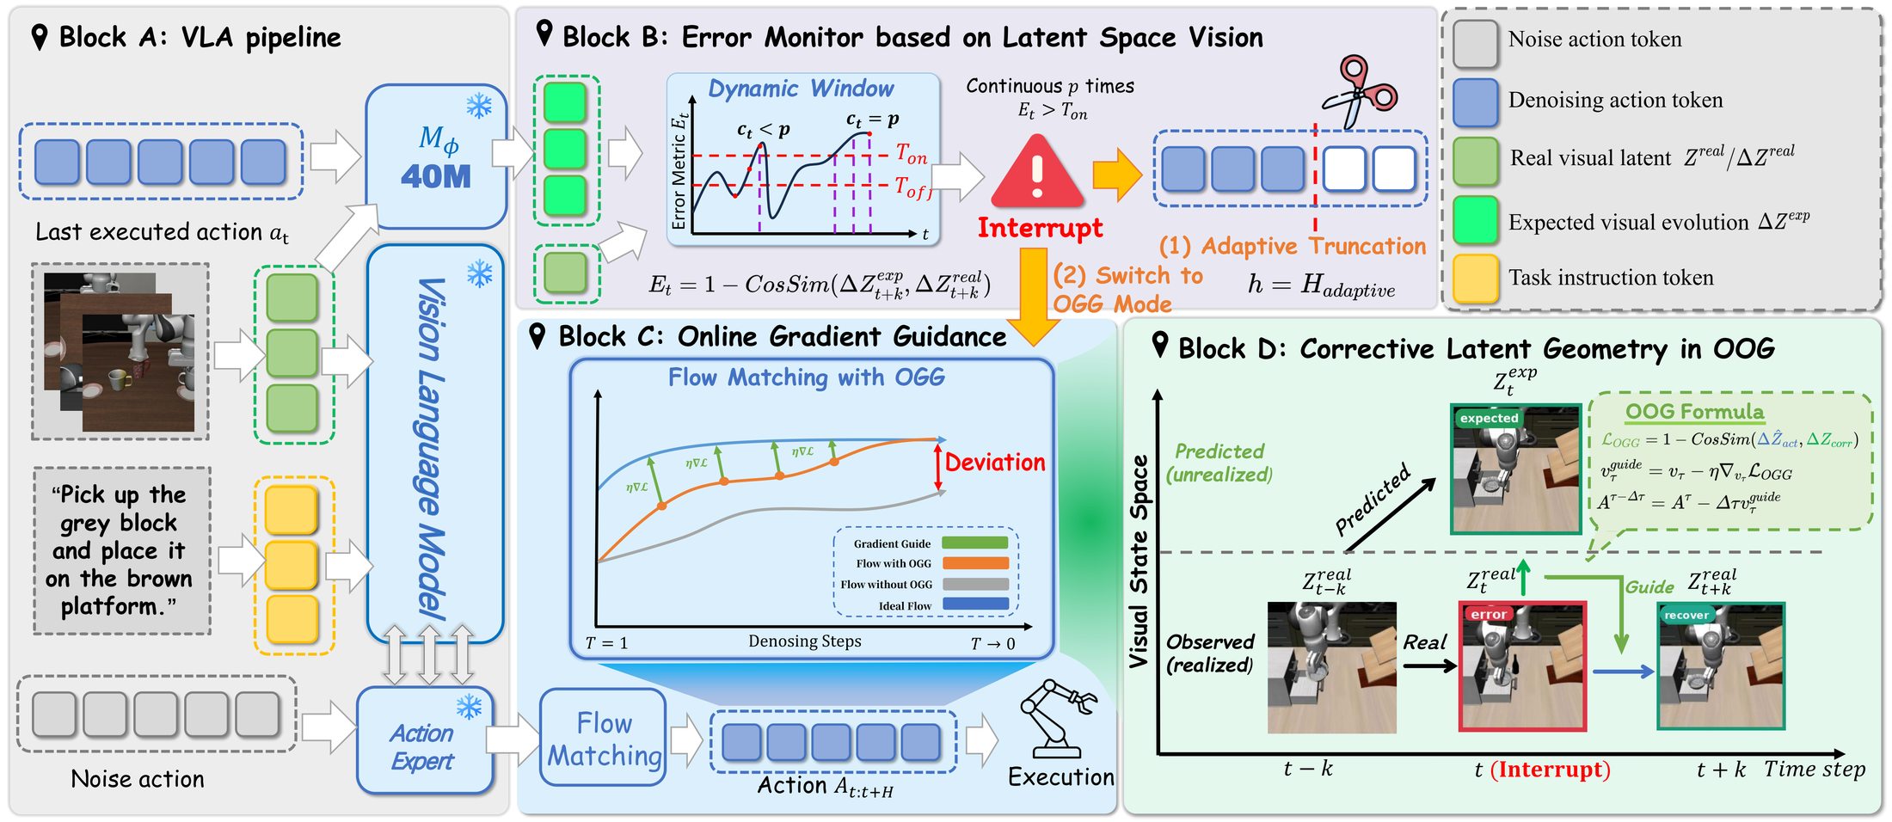
02 METHOD
Detect drift, truncate stale chunks, guide recovery.
01
Frozen VLA backbone with an external latent dynamics corrector.
02
Latent-space Vision Monitor detects persistent visual dynamics mismatch.
03
Online Gradient Guidance is applied only to the recovery query.

Slide 5
03 CORRECTOR
A small external model instead of full VLA retraining.
Trainable component
Policy backbone
Action horizon
~40M
Frozen
Adaptive
Residual MLP corrector at roughly 38-42M parameters.
The base VLA is not fully retrained.
Stable chunks continue; stale chunks are interrupted.
VLA-Corrector shows that robust VLA execution does not require heavier backbones or constant replanning.
By adding a lightweight detect-and-correct layer at inference time, it monitors latent visual dynamics, interrupts stale action chunks, and guides recovery only when execution drifts.
This provides a practical path to overcome open-loop blind spots with low cost, turning fixed horizons into adaptive, self-correcting execution.

Slide 6
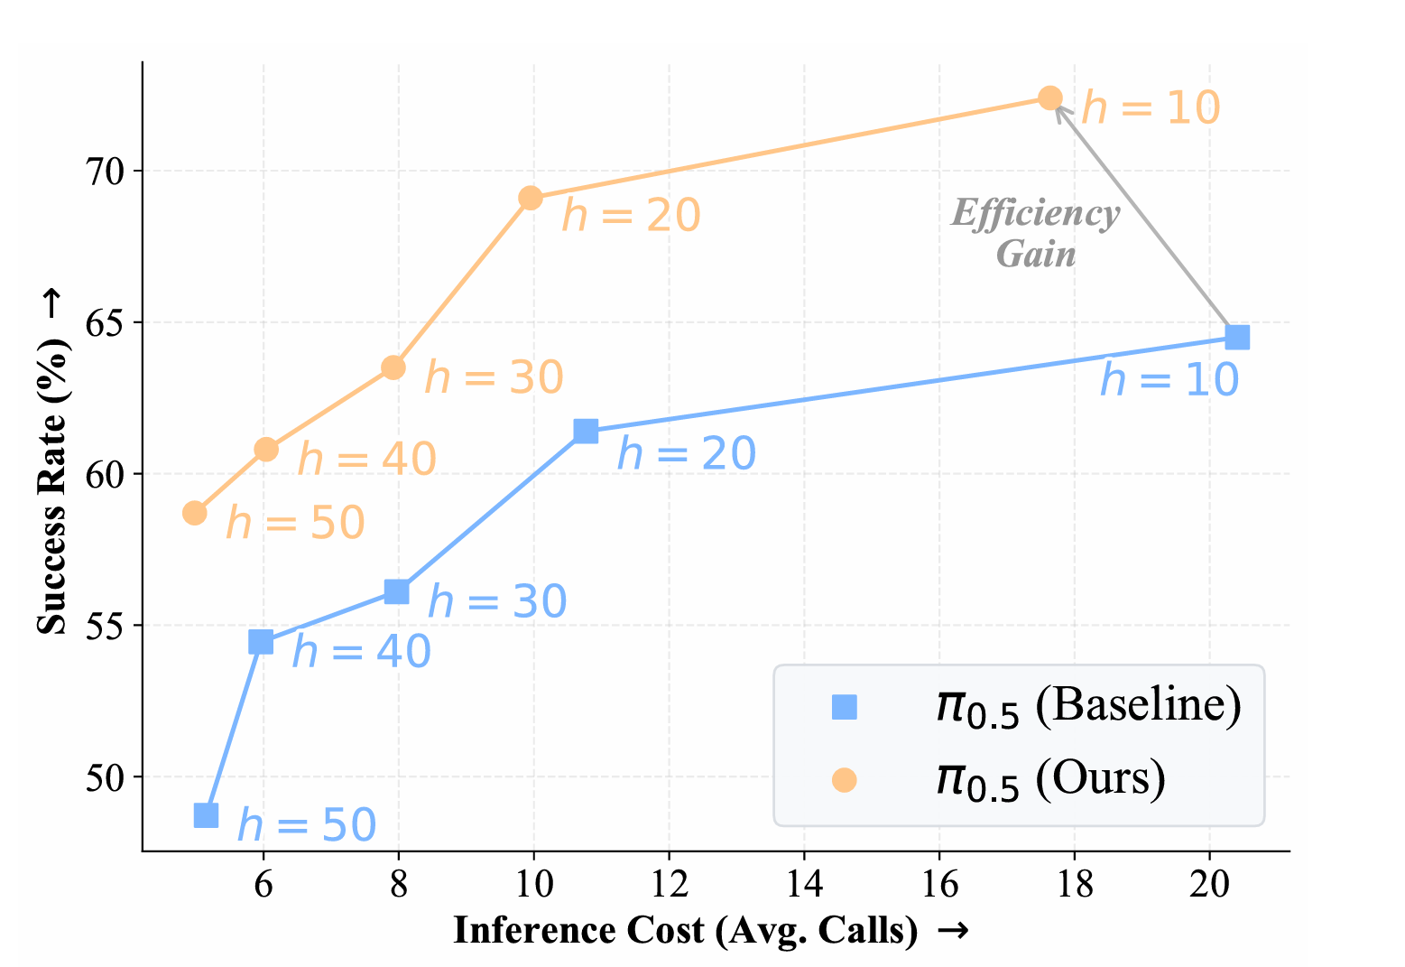
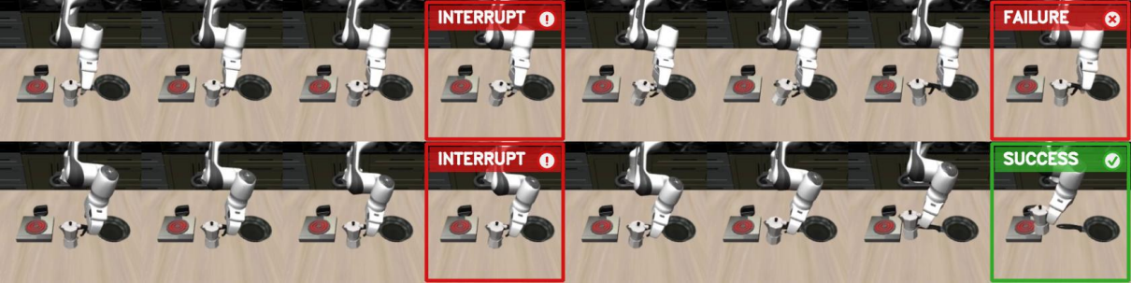
04 RESULTS
Reported gains across simulation and real robots.
MetaWorld / PI0.5
LIBERO / PI0.5
AgileX PiPER
Critical phases
+15.65 pts
+3.80 pts
+17.7 pts
83.7%
48.70% → 64.35% avg. success
94.00% → 97.80% few-shot success
55.6% → 73.3% real-world success
Truncations in manually labeled critical phases
Qualitative recovery: truncate stale chunk, replan with OGG, complete the task.

Slide 7
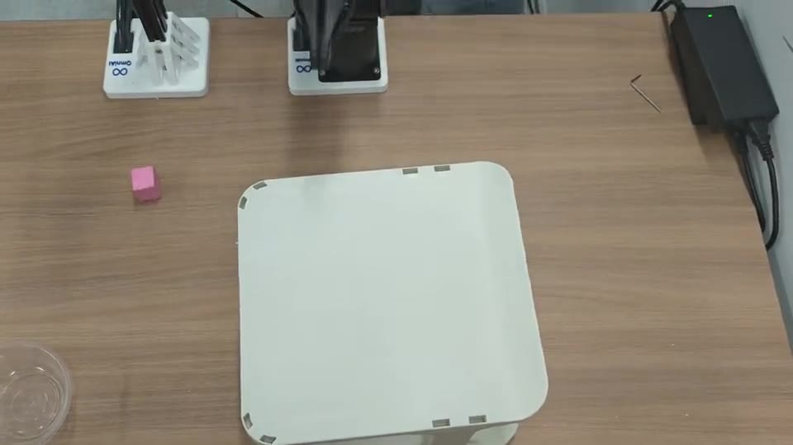
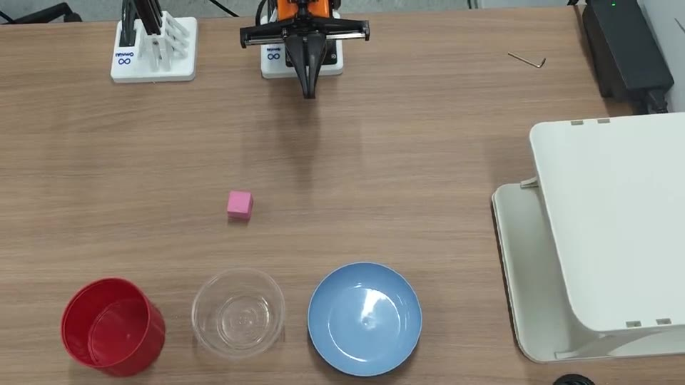
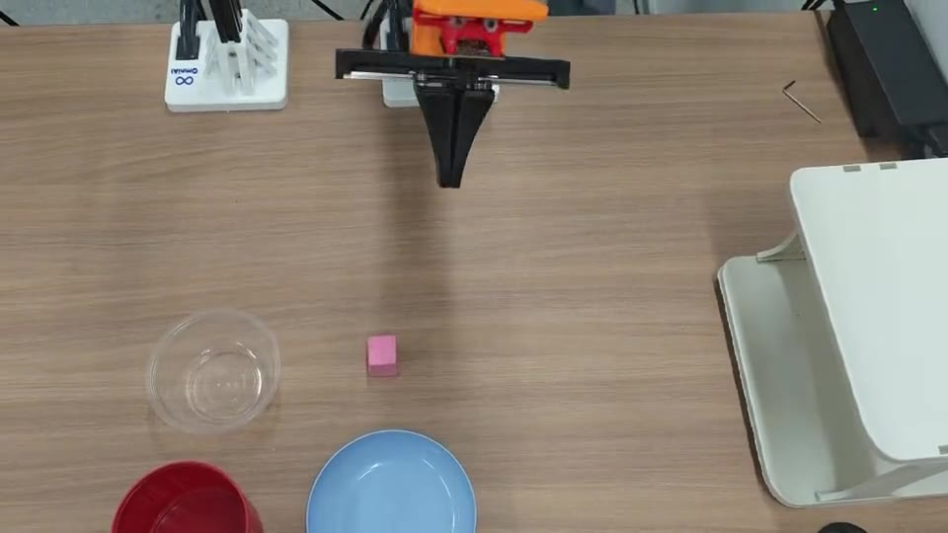
05 REAL ROBOTS
Perturbation demos are kept as silent project-page clips.
Drawer alignment
Block to blue bowl
Block to white bowl
Human moves the drawer during execution.
Target bowl is shifted mid-task.
Object/target perturbation during execution.

Slide 8

VLA-Corrector
Resources
Code
https://github.com/ZJU-OmniAI/vla-corrector
Project page
https://zju-omniai.github.io/vla-corrector/
Paper
https://arxiv.org/abs/2607.01804
Email
panyi0304@gmail.com、zhangwenqi@zju.edu.cn

